Slide 1
Rabin-Karp String Matching
Henry Chen, Amogh Ghadge, Yuyan Wang
Notes:
Yuyan

Slide 2
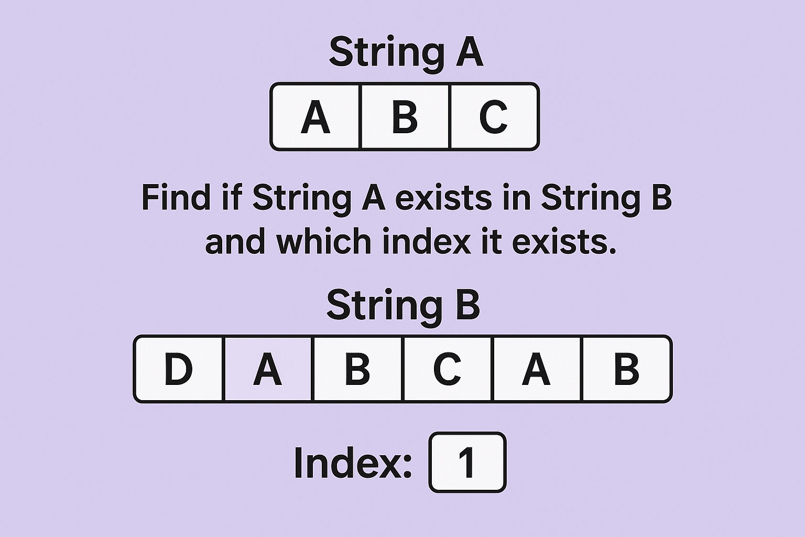
Problem Formulation
Problem: Find all occurrences of pattern in the text and return all indices they start at
Goal: Make the runtime faster than O(n*m), on average O(n+m).
n is the size of Text and m is the size of Pattern
Notes:
Yuyan

Slide 3
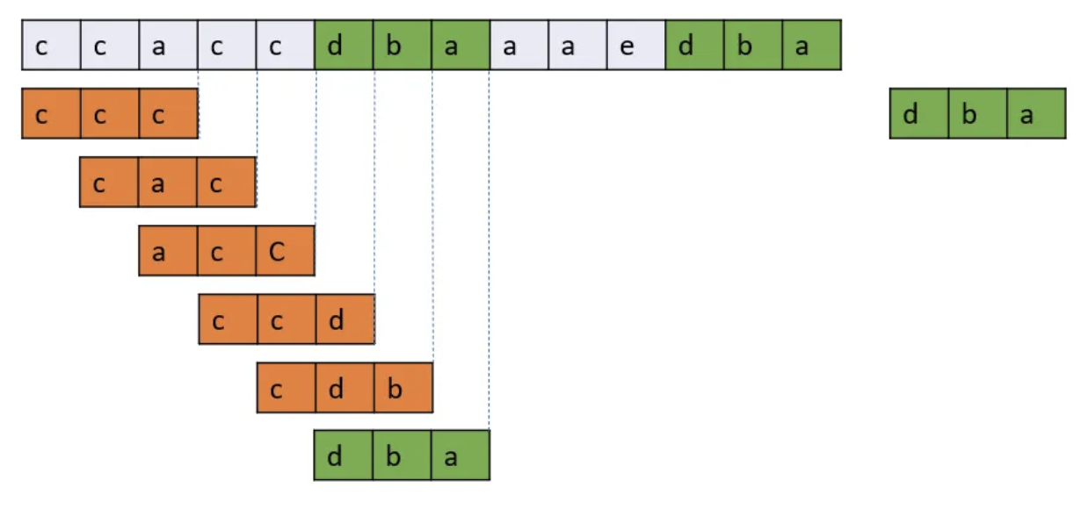
Naive Approach
Approach: Run through the String and check every possible substring.
Runtime: O(n*m) where the size of the string is N and the size of the pattern is M.
Notes:
Yuyan

Slide 4
Rabin-Karp String Matching Algorithm
What does Rabin-Karp do?
Hashes substrings by encoding characters in accordance with their order.
Computes hashes of new windows fast by utilizing the last hash value.
Variables:
T → the Text that we are going to find the pattern
d → number of possible characters in string space
q → a large prime number
S → substring with length m
U→ unicode of all characters
Notes:
Amogh

Slide 5

Hash Function: Example
Where:
S is the substring with length m
uS[i] is the Unicode of character at S[i]
d is the base
q is to prevent overflow
s1 = “acc”
hash(s1) = (‘c’ - ’a’ + 1) * 26^0 + (‘c’ - ’a’ + 1) * 26^1 + (‘a’ - ’a’ + 1) * 26^2
= 3 * 26^0 + 3 * 26^1 + 1 * 26^2
= 757
s2 = “cac”
hash(s1) = (‘c’ - ’a’ + 1) * 26^0 + (‘a’ - ’a’ + 1) * 26^1 + (‘c’ - ’a’ + 1) * 26^2
= 3 * 26^0 + 1 * 26^1 + 3 * 26^2
= 2057
set to a large prime number to avoid collisions
Notes:
Yuyan

Slide 6

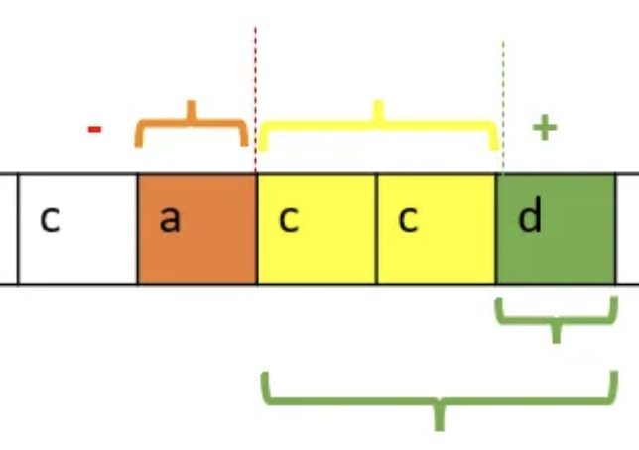
Rolling Hash: Example
Where:
hash is the hash value of substring
d is the base
u is the Unicode of all possible char
h is the highest order coefficient
q is a large prime
Hash of “acc” is 757
Unicode of “a” = (ord(“a”) - ord(“a”) + 1) = 1
Unicode of “d” = (ord(“d”) - ord(“a”)+ 1) = 4
d = 26
h = 26 ^ 2
Substring is represented by a three digit base 26 number
q = 10^ 9 + 7
New Hash = (26 * (757 - 1 * 26 ^ 2) + 4) mod (10^ 9 + 7)
New Hash = 2110
Notes:
Henry

Slide 7
Pseudocode
# find all indices in the text that match the pattern
def rabin_karp(text, pattern):
indices, base, q, target_hash, curr_hash, l = [], 26, 10**9 + 7, 0, 0, 0
# Compute the hash of the pattern
for i in range(len(pattern)):
# Go in reverse of pattern
target_hash = (target_hash * base + (ord(pattern[i]) + 1)) % q
# Sliding window
for r in range(len(text)):
curr_hash = (curr_hash * base + (ord(text[r]) + 1)) % q
# Rolling hash update
if r - l + 1 > len(pattern):
curr_hash = (curr_hash - (ord(text[l]) + 1) * pow(base, len(pattern), q)) % q
l += 1
# Check if the current window matches the pattern
if r - l + 1 == len(pattern) and curr_hash == target_hash:
if text[l:r+1] == pattern:
indices.append(l)
return indices
Notes:
Amogh

Slide 8
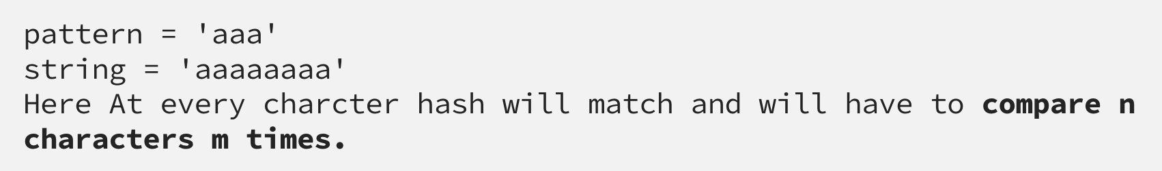
Time Complexity
Complexity:
Spurious hits are when the hash value of the pattern matches with the hash value of a window but the content of the window is not equal to the pattern
Occurs as a result of modding by q
Require manual check when hashes equal
The average case and best case complexity of Rabin-Karp algorithm is O(m + n) and the worst case complexity is O(mn).
Worst case occurs when pattern matches every window in the text
Notes:
Henry

